Slide 1
Hadoop 第二章:HDFS

Slide 2
目标
了解HDFS架构组件
使用shell命令操作存储在HDFS上的数据
HDFS API操作

Slide 3
HDFS: 特点
高容错
高吞吐量
在项目里处理大数据集
流式访问文件系统数据
可以构建在普通的硬件之上
Notes:
Hardware failure is the norm rather than the exception in HDFS. An HDFS instance may consist of hundreds or thousands of server machines, each storing part of the file system’s data. The fact that there are a huge number of components and each component has probability of failure means that some component of HDFS is always nonfunctional. Therefore, detection of faults, and quick and automatic recovery from failures is a core architectural goal of HDFS.
HDFS is optimized for large, streaming reads and writes rather than low-latency access to many small files. Batch performance is more important than real-time response times.
Applications that run on HDFS have large data sets. A typical file in HDFS is gigabytes to terabytes in size. Thus, HDFS is tuned to support large files. It should provide high aggregate data bandwidth and scale to hundreds of nodes in a single cluster. It should support tens of millions of files in a single instance. HDFS applications need a write-once-read-many access model for files. Once a file is created, written, and closed, it cannot be changed. This assumption enables high throughput data access.

Slide 4
HDFS 部署: 高可用(HA) 和非高可用
非高可用部署:
使用NameNode/Secondary NameNode 结构
Secondary NameNode 不是一种对NameNode失败重启方案.
在Hadoop 2.0 and CDH 4.0之前， NameNode存在单点失败问题Single Point of Failure (SPOF)
HA部署:
Active NameNode
Standby NameNode

Slide 5
HDFS 关键字定义
词 | 介绍
Cluster | A group of servers (nodes) on a network that are configured to work together. A server is either a master node or a slave (worker) node.
Hadoop | A batch processing infrastructure that stores and distributes files and distributes work across a group of servers (nodes).
Hadoop Cluster | A collection of Racks containing master and slave nodes
Blocks | HDFS breaks down a data file into blocks or "chunks" and stores the data blocks on different slave DataNodes in the Hadoop cluster.
Replication Factor | HDFS makes three copies of data blocks and stores on different DataNodes/Racks in the Hadoop cluster.
NameNode (NN) | A service (Daemon) that maintains a directory of all files in HDFS and tracks where data is stored in the HDFS cluster.
Secondary NameNode | Performs internal NameNode transaction log checkpointing
DataNode (DN) | Stores the blocks "chunks" of data for a set of files

Slide 6




NameNode (NN)
Blocks (chunks)
File: movieplex1.log
Blocks:
A, B, C
Data Nodes:
1, 2, 3
Replication Factor: 3
A: DN 1,DN 2, DN 3
B: DN 1,DN 2, DN 3
C: DN 1,DN 2, DN 3
. . .
A
B
C
movieplex1.log
NameNode存储文件系统元数据—内存中
File information (name, updates, replication factor, etc.)
File blocks information and locations
Access rights to the file
Number of files in the cluster
Number of DataNodes in the cluster
etc.
Notes:
HDFS has a master/slave architecture. An HDFS cluster consists of a single NameNode, a master server that manages the file system namespace (metadata) and controls access to files by client applications. In addition, there are several DataNodes, usually one per node in the cluster, which manage disks storage attached to the nodes that they run on. HDFS exposes a file system namespace and allows user data to be stored in files. Internally, a file is split into blocks or "chunks" and these blocks are stored in a set of DataNodes. The NameNode executes file system namespace operations like opening, closing, and renaming files and directories. It also determines and maintains the mapping of blocks to DataNodes in the cluster. The DataNodes are responsible for serving read and write requests from the file system’s client applications. The DataNodes also perform block creation, deletion, and replication upon instruction from the NameNode.
The NameNode is the service that stores the file system metadata and maintains a complete picture of the file system. Clients connect to the NameNode to perform file system operations. Block data is streamed to and from DataNodes directly, so bandwidth is not limited by a single node. DataNodes regularly report their status to the NameNode in a heartbeat. This means that, at any given time, the NameNode has a complete view of all of the DataNodes in the cluster, their current health, and what blocks they have available.

Slide 7
NameNode作用
存储HDFS 所有元数据
维护文件系统的命名空间
执行对文件或者目录进行打开，关闭，重命名等指令
保存HDFS状态在一个镜像文件 (fsimage)
在日志文件(edits)中保存对文件系统的修改
在启动的时候，合并fsimage和edits文件, 然后清空edits文件
在多racks中定位重复的(容灾) blocks
记录应用中制定文件重复因子
Notes:
The NameNode stores modifications to the file system as a log appended to a native file system file named edits. When a NameNode starts up, it reads HDFS state from an image file named fsimage, and then applies the edits from the edits log file. Next, it writes the new HDFS state to the fsimage file, and then starts normal operation with an empty edits file. Because NameNode merges the fsimage and edits files only during startup, the edits log file could get very large over time on a busy cluster. Another side effect of a larger edits file is that the next restart of the NameNode will take longer time.

Slide 8

Secondary NameNode (Non-HA)
Client
NameNode
Secondary NameNodes
Blocks (chunks)
File: movieplex1.log
Blocks:
A, B, C
Data Nodes:
1, 2, 3
Replication Factor: 3
A: DN 1,DN 2, DN 3
B: DN 1,DN 2, DN 3
C: DN 1,DN 2, DN 3
. . .
File: movieplex1.log
Blocks:
A, B, C
Data Nodes:
1, 2, 3
Replication Factor: 3
A: DN 1,DN 2, DN 3
B: DN 1,DN 2, DN 3
C: DN 1,DN 2, DN 3
. . .
A
B
C
movieplex1.log
Secondary NameNode:
The Secondary NameNode acts as a backup of NameNode metadata that can be imported (if necessary) to the primary NameNode.
Performs checkpointing to the NameNode
Runs on a different machine
Has a directory structure identical to the NameNode directory
Is not an immediate standby for the NameNode because it connects to the NameNode every hour
Notes:
The Secondary NameNode does not provide failover capability. The HDFS High Availability (HA) feature in Hadoop provides the failover capability as discussed in the later slides in this lesson.
The secondary NameNode merges the fsimage and the edits log files periodically and keeps the edits log size within a limit. It is usually run on a different machine than the primary NameNode because its memory requirements are on the same order as the primary NameNode. The secondary NameNode stores the latest checkpoint in a directory, which is structured the same way as the primary NameNode's directory so that the check fsimage file is always ready to be read by the primary NameNode if necessary.
The Checkpoint Node Daemon performs periodic checkpoints of the namespace and helps minimize the size of the log stored at the NameNode containing changes to the HDFS. It replaces the role previously filled by the Secondary NameNode.
The Backup Node Daemon performs checkpointing and also receives the edits from the NameNode and maintains its own in-memory copy of the namespace, which is always in sync with the Active NameNode namespace state.

Slide 9
NameNode恢复
NameNode失效后，一般满足以下情形才能相应服务：
将命名空间的fsimage导入内存中
重做编辑日志----edits文件
接收到足够多的来自datanode的数据块报告并退出安全模式
对于一个大型并拥有大量文件和数据块的集群，namenode的冷启动时间需要30分钟，甚至更多

Slide 10

DataNodes (DN)
Blocks
NameNode (Master)
A (128 MB)
File: movieplex1.log
Blocks: A, B, C
Data Nodes: 1, 2, 3
Replication Factor: 3
A: DN 1,DN 2, DN 3
B: DN 1,DN 2, DN 3
C: DN 1,DN 2, DN 3
. . .
Client
B (128 MB)
C (94 MB)
movieplex1.log; 350 MB in size and a block size of 128 MB. The Client chunks the file into (3) blocks: A, B, and C
Heartbeat & Blockreport
Heartbeat (every 3 sec) & Blockreport (every
6 hours)
A
B
C
A
. . .
B
C
Data Node 1 (slave)
Data Node 2 (slave)
Notes:
Data nodes report their status to the NameNode by using heartbeat messages and Blockreport to detect and ensure connectivity between the NameNode and the DataNodes. Receipt of a Heartbeat implies that the DataNode is functioning properly. A Blockreport contains a list of all blocks that are available on a DataNode. When a heartbeat is no longer present, the NameNode assumes that the DataNode is no longer functional and it unmaps the DataNode from the cluster and keeps on operating normally. When the heartbeat for the DataNode returns (or a new heartbeat appears), it is added to the cluster transparently without the user's intervention.
DataNodes use local disks in the commodity server for persistence. All the data blocks are stored locally, which improves performance. As mentioned earlier, the data blocks are replicated across several DataNodes. The default replication factor is 3 but that number is configurable. If one of the servers that contain one of the file's block fails, the file in question might not be corrupted. You can choose the degree of replication and the number of the DataNodes in the cluster when you implement the cluster. HDFS is dynamic in nature; therefore, all of the parameters can be adjusted during the operation of the cluster.

Slide 11
DataNodes作用
DataNodes perform the following functions:
对文件系统客户端的请求提供读写服务
基于NameNode对block执行创建，删除，复制备份
在备份(replication)期间提供同时对DataNodes进行发送/接收操作(“replication pipelining”)
Heartbeat every 3 seconds & Blockreport every 6 hours to NN
DataNode
A
C
B
Slave Node
Notes:
HDFS uses a master/slave architecture, with a single NameNode (master) managing multiple DataNodes (slaves). A typical HDFS deployment consists of a dedicated machine that runs only the NameNode software.
HDFS:
Manages the file system namespace and regulates access to files from clients
Executes file system namespace operations (open/close/rename files and directories)
Splits data into blocks (also known as “chunks”) for storage among DataNodes. The block size is configurable (it is typically 64 MB).
Replicates data to multiple machines/racks
Note: The Oracle BDA does not use a dedicated machine for the NameNode software. In addition, the HDFS block size on the BDA is 256 MB.

Slide 12
NameNode and Secondary NameNodes
NameNode and Secondary NameNodes (Masters)
Blocks
A (128 MB)
File: movieplex1.log
Blocks:
A, B, C
Data Nodes:
1, 2, 3
RF:3
A: DN 1,DN 2, DN 3
B: DN 1,DN 2, DN 3
C: DN 1,DN 2, DN 3
File: movieplex1.log
Blocks:
A, B, C
Data Nodes:
1, 2, 3
RF: 3
A: DN 1,DN 2, DN 3
B: DN 1,DN 2, DN 3
C: DN 1,DN 2, DN 3
. . .
Client
C (128 MB)
B (94 MB)
movieplex1.log; 350 MB in size and a block size of 128 MB. The Client chunks the file into (3) blocks: A, B, and C
A
B
C
C
A
B
B
C
A
DataNode 1 (slave)
DataNode 2 (slave)
DataNode 3 (salve)
Notes:
HDFS contains several DataNodes. The data that is stored in HDFS is divided into "chunks" or blocks and distributed across the DataNodes. The data blocks are also replicated to increase availability.

Slide 13

Storing and Accessing Data Files in HDFS
NameNode
Secondary NameNode
Blocks
File: movieplex1.log
Blocks: A, B, C
Data Nodes: 1, 2, 3
A: DN1,DN2, DN3
B: DN1,DN2, DN3
C: DN1,DN2, DN3
. . .
File: movieplex1.log
Blocks: A, B, C
Data Nodes: 1, 2, 3
A: DN1,DN2, DN3
B: DN1,DN2, DN3
C: DN1,DN2, DN3
. . .
A
B
C
movieplex1.log
Master
Master
Ack messages from the pipeline are sent back to the client (blocks are copied)
Slave
Slave
Slave
A
B
C
C
A
B
B
C
A
DataNode 1
DataNode 2
DataNode 3
Notes:
HDFS supports the capability to create data pipelines. A data pipeline is a connection between multiple DataNodes that exists to support the movement of data across the servers in the Hadoop cluster. A client application writes a block to the first DataNode in the pipeline. That DataNode takes over and forwards the data to the next node in the pipeline. This process is continued until all replicas are written to disk. At this point, the client repeats the process by writing the next block in the file to the first DataNode.
When a client is writing data to an HDFS file, its data is first written to a local file. Suppose the HDFS file has a replication factor of three. When the local file accumulates a full block of user data, the client retrieves a list of DataNodes from the NameNode. This list contains the DataNodes that will host a replica of that block. The client then flushes the data block to the first DataNode. The first DataNode starts receiving the data in small portions, writes each portion to its local repository, and transfers that portion to the second DataNode in the list. The second DataNode in turn starts receiving each portion of the data block, writes that portion to its repository, and then flushes that portion to the third DataNode. Finally, the third DataNode writes the data to its local repository. Thus, a DataNode can be receiving data from the previous one in the pipeline and at the same time forwarding data to the next one in the pipeline. Thus, the data is pipelined from one DataNode to the next.

Slide 14
Secondary NameNode, Checkpoint Node, and Backup Node
Node Type | Description
Secondary NameNode | Performs periodic checkpoints (housekeeping tasks) of the namespace and helps keep the size of file containing log file, edits, of HDFS modifications within certain limits at the NameNode. This is not a backup NameNode.
Checkpoint Node | Performs periodic checkpoints of the namespace and helps minimize the size of the log stored at the NameNode containing changes to the HDFS. Replaces the role previously filled by the Secondary NameNode. This is optional.
Backup Node | An extension to the Checkpoint node. In addition to checkpointing it also receives a stream of edits from the NameNode and maintains its own in-memory copy of the namespace, which is always in sync with the active NameNode namespace state. This is optional.
Notes:
The secondary NameNode merges the fsimage and the edits log files periodically and keeps edits log size within a limit. It is usually run on a different machine than the primary NameNode because its memory requirements are on the same order as the primary NameNode. The secondary NameNode stores the latest checkpoint in a directory, which is structured the same way as the primary NameNode's directory so that the check fsimage file is always ready to be read by the primary NameNode if necessary.
The Checkpoint Node Daemon performs periodic checkpoints of the namespace and helps minimize the size of the log stored at the NameNode containing changes to the HDFS. It replaces the role previously filled by the Secondary NameNode.
The Backup Node Daemon performs checkpointing and also receives the edits from the NameNode and maintains its own in-memory copy of the namespace, which is always in sync with the Active NameNode namespace state.

Slide 15
HDFS Architecture: HA
Component | Description
NameNode (Active) Daemon | 相应集群中所有的客户端操作
NameNode (Standby) Daemon | 一个slave NameNode或者热备份NameNode，其维护了足够的信息可以在需要(failover)时进行快速切换
DataNode Daemon | 数据进行存储(HDFS)和处理(MapReduce)节点． This is a slave node.
Hadoop 2.0 & later, CDH 4.0 & Later
NameNode
(Active)
master daemon
NameNode
(Standby)
master daemon
DataNode
slave daemon
Master Node
Master Node
Slave Node

Slide 16
HDFS High Availability (HA) Using the Quorum Journal Manager (QJM)
在Hadoop 2.0.0之前, NameNode存在单点失败single point of failure (SPOF).
每个集群有一个NameNode.
当NameNode节点故障或者软硬件维护的时候，集群是不可用的
HDFS HA 通过以下来处理上面的问题:
在一个集群中运行两个冗余的:
一个激活Active状态，一个热备用Hot Standby状态
当NameNode节点故障或者软硬件维护的时候，HA可以快速启用一个新的NameNode.
Oracle Big Data Appliance (BDA) uses the HA implementation.
Notes:
Prior to Hadoop 2.0.0, the NameNode was a single point of failure (SPOF) in an HDFS cluster. Each cluster had a single NameNode, and if that machine or process became unavailable, the cluster as a whole would be unavailable until the NameNode was either restarted or brought up on a separate machine.
This impacted the total availability of the HDFS cluster in two major ways:
If a machine crashed, the cluster would be unavailable until an operator restarted the NameNode.
Maintenance operations such as software or hardware upgrades on the NameNode machine would result in the cluster being down.
The HDFS High Availability feature addresses the preceding problems by providing the option of running two redundant NameNodes in the same cluster in an Active and Passive configuration with a hot standby. This allows a fast failover to a new NameNode in the case that a machine crashes, or a graceful administrator-initiated failover for the purpose of planned maintenance.

Slide 17
HDFS High Availability (HA) Using the Quorum Journal Manager (QJM) Feature
Active NameNode
Standby (Hot) NameNode
File: movieplex1.log
Blocks:
A, B, C
Data Nodes:
1, 2, 3
RF: 3
A: DN 1,DN 2, DN 3
B: DN 1,DN 2, DN 3
C: DN 1,DN 2, DN 3
. . .
File: movieplex1.log
Blocks:
A, B, C
Data Nodes:
1, 2, 3
RF: 3
A: DN 1,DN 2, DN 3
B: DN 1,DN 2, DN 3
C: DN 1,DN 2, DN 3
. . .
Heartbeats &
Blockreports
Up-to-date blocks locations
Monitors changes
in JNs
Applies JNs changes to its own namespace
Namespace changes
A
C
B
Active & Standby
NNs locations
DataNode 1
JournalNodes (JNs) Daemons
Notes:
In a typical HA cluster, two separate machines are configured as NameNodes. At any point in time, exactly one of the NameNodes is in an Active state, and the other is in a Standby state. The Active NameNode is responsible for all client operations in the cluster, while the Standby is simply acting as a slave, maintaining enough information to provide a fast failover if necessary.
The Standby NameNode maintains its state synchronized with the Active NameNode by communicating with a group of separate daemons named JournalNodes (JNs). When the Active NameNode performs any namespace modification, it logs a record of the modification to most of the JNs. The Standby NameNode can read the edits from the JNs and is constantly monitoring changes in the edits file. If the Standby NameNode sees the edits, it applies them to its own namespace. In the event of failover in the Active NameNode, the Standby ensures that it has read all of the edits from the JNs before promoting itself to the Active NameNode state. This ensures that the namespace state is fully synchronized before a failover occurs.

Slide 18
HDFS High Availability (HA) Using the Quorum Journal Manager (QJM) Feature
HA中的Standby NameNode同时对namespace状态进行checkpoints操作,这样在集群中就不需要以下节点:
A Secondary NameNode
A CheckpointNode
A BackupNode
如果把HA又配置为了non-HA，则需要使用Secondary NameNode.

Slide 19
配置HA集群硬件资源
部署一个基于Quorum的HA集群，需要准备一下机器:
Active NameNode
Standby (Hot) NameNode
File: movieplex1.log
Blocks:
A, B, C
Data Nodes:
1, 2, 3
RF: 3
A: DN 1,DN 2, DN 3
B: DN 1,DN 2, DN 3
C: DN 1,DN 2, DN 3
. . .
File: movieplex1.log
Blocks:
A, B, C
Data Nodes:
1, 2, 3
RF: 3
A: DN 1,DN 2, DN 3
B: DN 1,DN 2, DN 3
C: DN 1,DN 2, DN 3
. . .
A
C
B
Active & Standby
NNs locations
DataNode 1
JournalNodes (JNs) Daemons
Notes:
To deploy an HA cluster, you should prepare the following:
The NameNode machines on which you will run the Active and Standby NameNodes.
The JournalNode machines on which you will run the JournalNodes. The JournalNode daemon is relatively lightweight, so you can run them on the Master hosts machines with other Hadoop daemons such as the NameNodes, the JobTracker, or the YARN ResourceManager. You must have at least three JournalNodes (but can run more than three JNs) daemons because the edit log file modifications must be written to a majority of JNs. This will allow the system to tolerate the failure of a single machine. You may also run more than three JournalNodes, but to actually increase the number of failures the system can tolerate, you should run an odd number of JNs (that is, 3, 5, 7, and so on). Note that when running with N JournalNodes, the system can tolerate at most (N - 1) / 2 failures and continue to function normally.

Slide 20
Enabling HDFS HA
使用Cloudera Manager
打开HA和故障自动切换(Failover)
使用命令行配置故障自动切换(Failover).故障自动切换在HDFS部署上添加了以下组件:
ZooKeeper quorum提供:
故障检测
Active NameNode选举
ZKFailoverController (ZKFC)程序提供:
健康检测
ZooKeeper会话管理
基于ZooKeeper的选举
Notes:
Zookeeper is used to monitor the Active NameNode and to handle the failover logistics if the Active NameNode becomes unavailable.
Both the Active and Standby NameNodes have dedicated Zookeeper Failover Controllers (ZFC) that perform the monitoring and failover tasks. In the event of a failure, the ZFC informs the Zookeeper instances on the cluster, which then elect a new Active NameNode.
This course does not cover the details on how to enable HA automatic failover by using Cloudera Manager or details on how to use the command-line interface to configure automatic failover.
Note
For details on how to enable HA and automatic failover by using Cloudera Manager, see the following Cloudera website: http://www.cloudera.com/content/cloudera/en/documentation/core/latest/topics/cdh_hag_hdfs_ha_enabling.html#cmug_topic_5_12_7_unique_2
For detailed information on how to use the command-line interface to configure automatic failover, see the following Apache website: http://hadoop.apache.org/docs/stable/hadoop-project-dist/hadoop-hdfs/HDFSHighAvailabilityWithQJM.html

Slide 21
HDFS上基于Rack的数据备份
Block A :
A
Block B :
B
Block C :
C
Rack 1
Rack 2
Rack 3
1
5
9
A
A
2
6
10
C
A
B
B
3
7
11
C
B
4
8
12
C
Notes:
The diagram shown in the slide illustrates the rack-awareness in HDFS. The replication process is explained in the next slide.
The placement of replicas is critical to HDFS reliability and performance. The purpose of a rack-aware replica placement policy is to improve data reliability, availability, and network bandwidth utilization.

Slide 22


数据备份处理
HDFS中文件备份数量(“replication factor”)存储在NameNode.
如果备份数量是3, HDFS使用以下策略放置数据:
一份放置在本地rack的一个节点
一份放置在远程rack的一个节点
一份放置在远程同一个rack的另外一个节点
这种策略提高了写性能并且保证了数据的可靠性和可用性.
如果需要读取数据，HDFS获取最近的备份(本地数据).
Notes:
The NameNode uses the Hadoop Rack Awareness process to determine the rack ID to which each DataNode belongs. A simple but nonoptimal policy is to place replicas on unique racks. This prevents losing data when an entire rack fails and allows use of bandwidth from multiple racks when reading data. This policy evenly distributes replicas in the cluster, which makes it easy to balance load on component failure. However, this policy increases the cost of writes because a write needs to transfer blocks to multiple racks.
For the common case, when the replication factor is three, HDFS’s placement policy is to put one replica on one node in the local rack, another on a node in a different (remote) rack, and the last on a different node in the same remote rack. This policy reduces the inter-rack write traffic, which generally improves write performance. The chance of rack failure is far less than that of node failure; this policy does not impact data reliability and availability guarantees. However, it does reduce the aggregate network bandwidth used when reading data because a block is placed in only two unique racks rather than three. With this policy, the replicas of a file do not evenly distribute across the racks. One-third of replicas are on one node, two-thirds of replicas are on one rack, and the other third are evenly distributed across the remaining racks. This policy improves write performance without compromising data reliability or read performance.

Slide 23
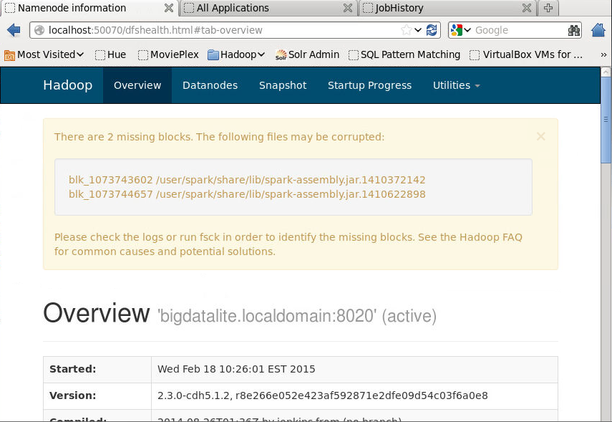
Accessing HDFS
Notes:
The following are the web URLs to access HDFS:
NameNode status: http://localhost:50070/dfshealth.jsp
DataBlock Scanner Report: http://localhost:50075/blockScannerReport

Slide 24
Agenda
了解HDFS架构组件
使用shell命令操作存储在HDFS上的数据

Slide 25
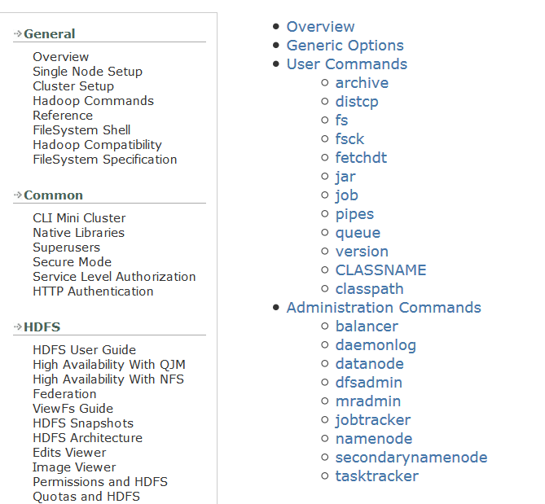
HDFS Commands
Notes:
You can access the Hadoop Command Reference by using the following url:
http://hadoop.apache.org/docs/stable/hadoop-project-dist/hadoop-common/CommandsManual.html#Administration_Commands

Slide 26
The File System Namespace: The HDFS FS (File System) Shell Interface
HDFS提供传统的分级文件组织方式.
使用 FS shell 命令行接口可以和HDFS中的数据进行交互. 命令集接口和其他是shell(如，bash，csh)命令类似
可以创建，删除，重命名，移动文件/目录.
在FS shell通过下面的方式调用:
通用的命令行语法:
hadoop fs <args>
hadoop command [genericOptions] [commandOptions]
Notes:
HDFS supports a traditional hierarchical file organization. A user or an application can create directories and store files inside these directories. The file system namespace hierarchy is similar to most other existing file systems; one can create and remove files, move a file from one directory to another, or rename a file. HDFS does not yet implement user quotas. HDFS does not support hard links or soft links. However, the HDFS architecture does not preclude implementing these features.
HDFS organizes data in the form of files and directories. It provides a command-line interface named FS shell that enables you to interact with the data stored in HDFS. The syntax of this command set is similar to other shells such as bash and csh.
The File System (FS) shell includes various shell-like commands that directly interact with the Hadoop Distributed File System (HDFS). You can invoke the FS shell as follows:
hadoop fs <args>
For information about the FS shell commands, see the FileSystem shell site at:
http://hadoop.apache.org/docs/current/hadoop-project-dist/hadoop-common/FileSystemShell.html

Slide 27
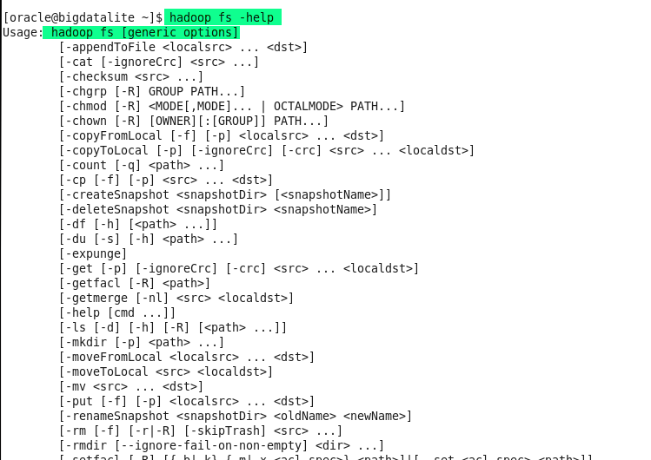
The File System Namespace: The HDFS FS (File System) Shell Interface
hadoop fs -help
Notes:
HDFS supports a traditional hierarchical file organization. A user or an application can create directories and store files inside these directories. The file system namespace hierarchy is similar to most other existing file systems; one can create and remove files, move a file from one directory to another, or rename a file. HDFS does not yet implement user quotas. HDFS does not support hard links or soft links. However, the HDFS architecture does not preclude implementing these features.
HDFS organizes data in the form of files and directories. It provides a command-line interface named FS shell that enables you to interact with the data stored in HDFS. The syntax of this command set is similar to other shells such as bash and csh.
For information about the FS shell commands, see the FileSystem shell site at:
http://hadoop.apache.org/docs/current/hadoop-project-dist/hadoop-common/FileSystemShell.html

Slide 28
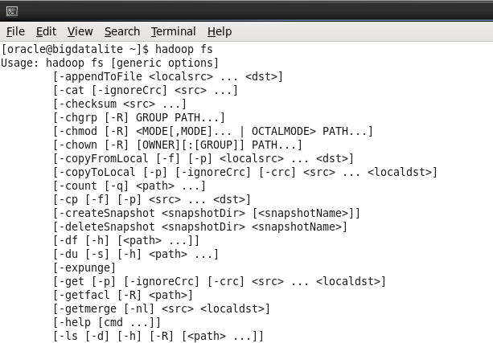
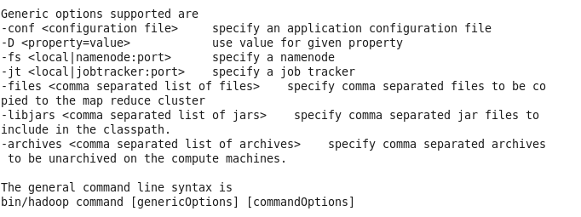
Accessing HDFS
Notes:
Using the Oracle Linux command-line terminal, you can access HDFS and load data from the log files.
HDFS commands are similar to Linux commands.
Note: The prefix hadoop must be added to all commands as shown in the first screenshot in the slide.

Slide 29
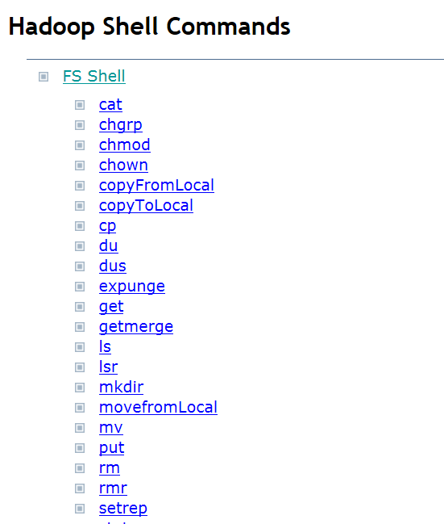
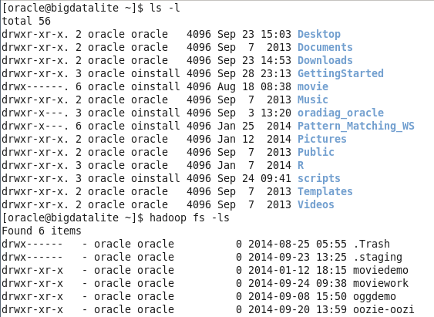
FS Shell Commands
Notes:
The first screenshot in the slide titled Hadoop Shell Commands shows the FS shell commands, which are available from the FileSystem shell site at:
http://hadoop.apache.org/docs/current/hadoop-project-dist/hadoop-common/FileSystemShell.html
The second screenshot in the slide shows using the ls command on both the local file system and on the hadoop namespace, which returns different results.

Slide 30
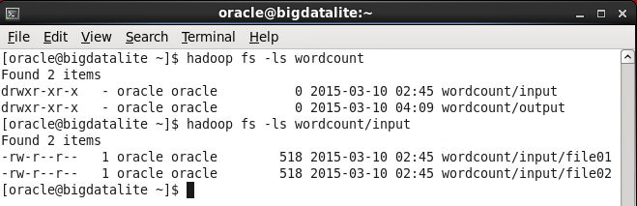
Basic File System Operations: Examples
hadoop fs -ls
directories
files
文件显示的各列信息:
permissions number_of_replicas userid groupid filesize modification_date modification_time filename
目录显示各列信息:
permissions userid groupid modification_date modification_time dirname
Notes:
In the two screen captures examples shown in the slide, the ls command is used to get an HDFS file listing for the HDFS wordcount and wordcount/input directories.
Column 1 shows the file mode: "d" for a directory and a "–" for a normal file, followed by the file or directory permission. HDFS has a permissions model similar to that used in Linux. The three permission types are: read (r), write (w), and execute (x). The execute permission for a file is ignored because you cannot execute a file on HDFS. The permissions are grouped by owner, group, and public (everyone else). The second column shows the replication factor for files. The concept of replication factor does not apply to directories. Columns 3 and 4 show the file owner and group. Column 5 shows the size of the file, in bytes, or 0 if it is a directory. Columns 6 and 7 show the date and time of the last modification, respectively. Column 8 is the name of the file or directory.

Slide 31
Sample FS Shell Commands
Command | Description
cat | Copies source paths to stdout.
copyFromLocal | Copies a file from the local file system to HDFS. This command is similar to get command, except that the destination is restricted to a local file reference.
copyToLocal | Copies a file from HDFS to the local file system. This command is similar to get command, except that the destination is restricted to a local file reference.
cp | Copy files from source to destination in HDFS
get | Copies files from HDFS to the local file system
jar | Runs a jar file. Users can bundle their Map Reduce code in a jar file and execute it using this command.
mkdir | Creates one or more HDFS directories
mv | Moves files from source to destination. Moving files across file systems is not permitted.
put | Copies files from the local file system to HDFS
Rm | Deletes files specified. The -r option deletes the directory and its contents.
version | Prints the Hadoop version

Slide 32
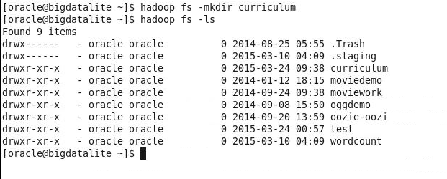
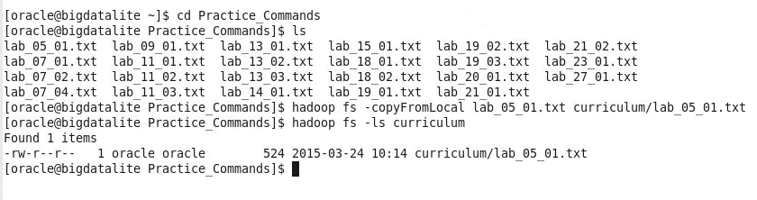
Basic File System Operations: Examples
Create an HDFS directory named curriculum by using the mkdir command:
Copy lab_05_01.txt from the local file system to the curriculum HDFS
directory by using the copyFromLocal command:

Slide 33
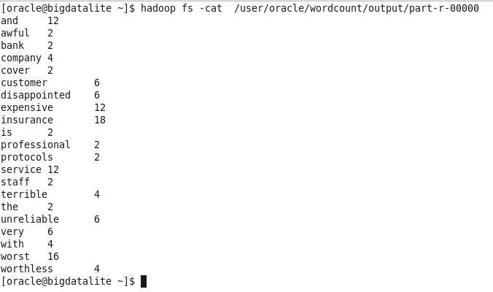
Basic File System Operations: Examples
Delete the curriculum HDFS directory by using the rm command. Use the -r option to delete the directory and any content under it recursively:
Display the contents of the part-r-00000 HDFS file by using the cat command:

Slide 34
HDFS Administration Commands
Command | Description
namenode -format | Formats the DFS file system
secondarynamenode | Runs the DFS secondary NameNode
namenode | Runs the DFS NameNode
datanode | Runs a DFS DataNode
balancer | Runs a cluster-balancing utility
fsck - / | Runs a DFS file system checking utility
jobtracker | Runs the mapreduce job tracker node
tasktracker | Runs a mapreduce task tracker node
Notes:
The table in the slide shows some of the available administration commands that are useful for administrators of a Hadoop cluster.
For detailed information on using the commands shown in the slide, see the following URL:
http://hadoop.apache.org/docs/stable/hadoop-project-dist/hadoop-common/CommandsManual.html#Administration_Commands

Slide 35
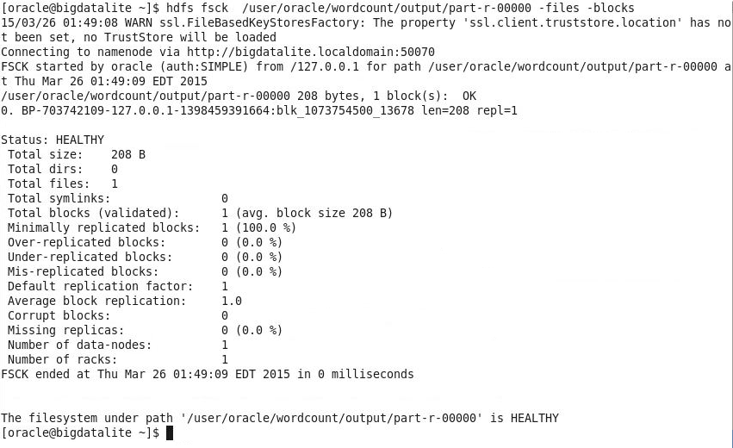
Using the hdfs fsck Command: Example
Notes:
fsck can be run on the whole file system or on a subset of files.
The slide example shows how to use the hdfs fsck command on a single file to find out the blocks for that file in addition to some other useful information. In this course, you are using the BDLite VM, which is only one node; therefore, no files are being replicated.

Slide 36
HDFS 特点和优势
HDFS provides the following features and benefits:
在DataNodes 均匀的保存数据
file system checking utility (fsck) 在文件系统中执行健康检测
按程序进行升级和回滚
使用secondary NameNode进行恢复并且保证edits日志文件在指定大小范围
备用节点在内存保存了一份NameNode 的内容

Slide 37
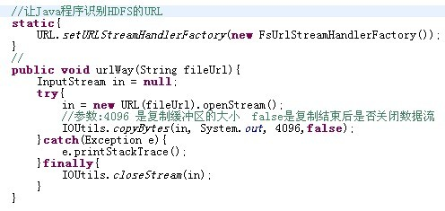
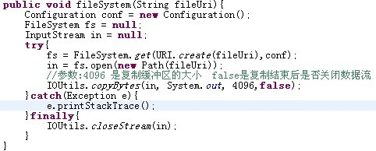
HDFS的JavaAPI_读文件
java.net.URL
org.apache.hadoop.io.IOUtils
org.apache.hadoop.fs.FsUrlStreamHandlerFactory
"hdfs://192.168.200.128:9000/test/test.txt"
java.net.URI
org.apache.hadoop.conf.Configuration
org.apache.hadoop.fs.FileSystem
org.apache.hadoop.fs.Path
org.apache.hadoop.io.IOUtils

Slide 38
HDFS的java访问接口——FileSystem
写文件 create
读取文件 open
删除文件delete
创建目录 mkdirs
删除文件或目录 delete
列出目录的内容 listStatus
显示文件系统的目录和文件的元数据信息 getFileStatus

Slide 39
HDFS的FileSystem读取文件
private static FileSystem getFileSystem() throws URISyntaxException, IOException {
Configuration conf = new Configuration();
URI uri = new URI("hdfs://master:9000");
final FileSystem fileSystem = FileSystem.get(uri , conf);
return fileSystem;
}

Slide 40
HDFS的FileSystem读取文件
/**
* 读取文件，调用fileSystem的open(path)
* @throws Exception
*/
private static void readFile() throws Exception {
FileSystem fileSystem = getFileSystem();
FSDataInputStream openStream = fileSystem.open(new Path("hdfs://master:9000/aaa"));
IOUtils.copyBytes(openStream, System.out, 1024, false);
IOUtils.closeStream(openStream);
}

Slide 41
HDFS的FileSystem目录
/**
* 创建目录，调用fileSystem的mkdirs(path)
* @throws Exception
*/
private static void mkdir() throws Exception {
FileSystem fileSystem = getFileSystem();
fileSystem.mkdirs(new Path("hdfs://master:9000/bbb"));
}
/**
* 删除目录，调用fileSystem的deleteOnExit(path)
* @throws Exception
*/
private static void rmdir() throws Exception {
FileSystem fileSystem = getFileSystem();
fileSystem.delete(new Path("hdfs://master:9000/bbb"));
}

Slide 42
HDFS的FileSystem遍历目录
/**
* 遍历目录，使用FileSystem的listStatus(path)
* 如果要查看file状态，使用FileStatus对象
* @throws Exception
*/
private static void list() throws Exception{
FileSystem fileSystem = getFileSystem();
FileStatus[] listStatus = fileSystem.listStatus(new Path("hdfs://master:9000/"));
for (FileStatus fileStatus : listStatus) {
String isDir = fileStatus.isDir()?"目录":"文件";
String name = fileStatus.getPath().toString();
System.out.println(isDir+" "+name);
}
}

Slide 43
FileSystem
用户代码操作HDFS时，是直接调用FileSystem的子类完成的。

Slide 44
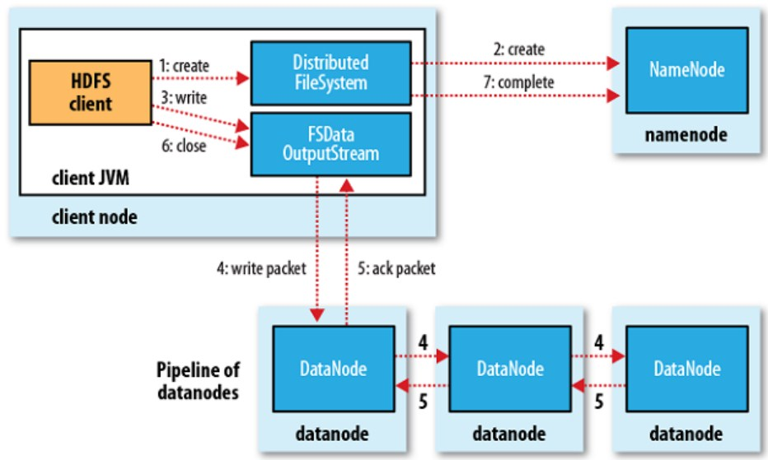
HDFS的存储机制

Slide 45
Remote Procedure Call
RPC——远程过程调用协议，它是一种通过网络从远程计算机程序上请求服务，而不需要了解底层网络技术的协议。RPC协议假定某些传输协议的存在，如TCP或UDP，为通信程序之间携带信息数据。在OSI网络通信模型中，RPC跨越了传输层和应用层。RPC使得开发包括网络分布式多程序在内的应用程序更加容易。
RPC采用客户机/服务器模式。请求程序就是一个客户机，而服务提供程序就是一个服务器。首先，客户机调用进程发送一个有进程参数的调用信息到服务进程，然后等待应答信息。在服务器端，进程保持睡眠状态直到调用信息的到达为止。当一个调用信息到达，服务器获得进程参数，计算结果，发送答复信息，然后等待下一个调用信息，最后，客户端调用进程接收答复信息，获得进程结果，然后调用执行继续进行。
hadoop的整个体系结构就是构建在RPC之上的(见org.apache.hadoop.ipc)

Slide 46
RPC示例
public interface ClientProtocol extends VersionedProtocol{
//版本号，默认情况下，不同版本号的RPC客户端与Server之间不能相互通信
public static final long versionID = 1L;
public String hello(String msg) throws IOException;
}
public class ClientProtocolImpl implements ClientProtocol{
public long getProtocolVersion(String protocol, long clientVersion)
throws IOException {
return versionID;
}
public ProtocolSignature getProtocolSignature(String protocol,
long clientVersion, int clientMethodsHash) throws IOException {
return new ProtocolSignature(versionID, null);
}
public String hello(String msg) throws IOException {
return "hello " + msg;
}
}

Slide 47
RPC示例
public class RPCServer {
private static final String HOST = "localhost";
private static final int PORT = 2181;
public static void main(String[] args) throws IOException {
Configuration conf = new Configuration();
Server server = new RPC.Builder(conf).setProtocol(ClientProtocol.class)
.setInstance(new ClientProtocolImpl()).setBindAddress(HOST)
.setNumHandlers(2)
.setPort(PORT).build();
server.start();
}
}

Slide 48
RPC示例
public class RPCClient {
private static final String HOST = "localhost";
private static final int PORT = 2181;
public static void main(String[] args) throws IOException {
Configuration conf = new Configuration();
ClientProtocol proxy = (ClientProtocol) RPC.getProxy(ClientProtocol.class, ClientProtocol.versionID,
new InetSocketAddress(HOST, PORT), conf);
String result = proxy.hello("world");
System.out.println(result);
}
}

Slide 49
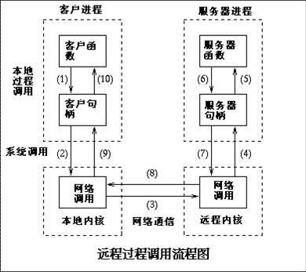
RPC调用流程

Slide 50
ClientProtocol
是客户端(FileSystem)与NameNode通信的接口。

Slide 51
DatanodeProtocol
是DataNode与NameNode通信的接口

Slide 52
NamenodeProtocol
是SecondaryNameNode与NameNode通信的接口。

Slide 53
DFSClient
是直接调用NameNode接口的对象。
用户代码是通过DistributedFileSystem调用DFSClient对象，才能与NameNode打交道

